Slide 1
An overview of R
And why it’s worth your time
Notes:
I know you’ve all already signed on, but I wanted to get you excited…

Slide 2
What is R?
A programming language custom-built to be good at complex statistics and data handling
Built with a set of core functions that can be added to by packages anyone can write
Now has the capabilities to manage everything from data to publication-quality output
Notes:
Being a programming language means a lot of things. It’s very powerful, very flexible, but also you have to learn how to program to get the most out of it.
(and many of the world’s best statisticians are writing R packages)
Because these statisticians have been writing packages for many years, R has been built up to be able to do pretty much anything that can feasible be done within the data-space.

Slide 3
Why should you care?
As new, advanced data analytic techniques are developed and popularised, journals want you to use them
Because of the completeness and constant updating of R, you won’t need to learn new programs every time you want to learn a new analysis.
Notes:
E.g. effect sizes, confidence intervals, SEM, now multilevel modelling, etc
Because most leading statistics buffs use R, the new techniques they develop tend to be implemented in R packages years before other programs
Once you learn R, it will be relatively easy to keep up with the latest techniques.

Slide 4
If you’re using SPSS and a reviewer asks for…
Structural Equation Modelling -> Learn Amos
Multi-level Modelling -> Learn HLM/Mplus
Power Analysis -> Learn G-Power (for simple stuff)
Social Network Analysis -> Learn Gephi
Textual Analysis -> Learn Leximancer
Bayesian Stats, Random Forests, Poisson Regressions, Complex Power Simulations -> ???

Slide 5
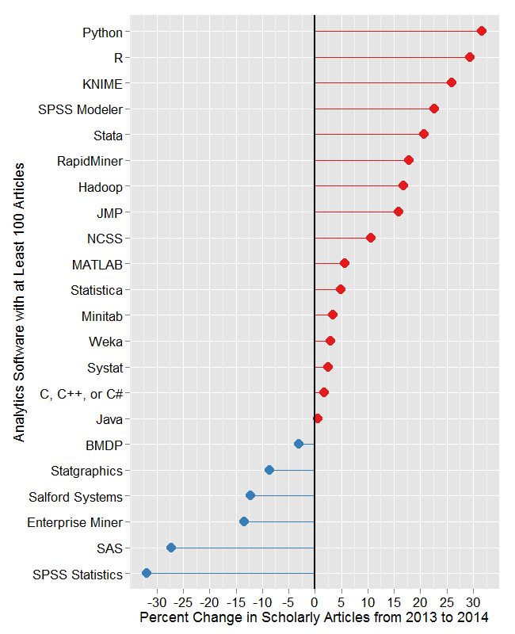
Notes:
Also, recently at SISPP, which is a social psych summer school that’s very competitive, I’d estimate that at least a quarter of grad students there were using R full-time and more than half knew how to use it on some level. almost 100% of them knew what it was and what it could do.

Slide 6
Other reasons to use R
It’s free (you’ll always have access)
It makes your research reproducible
It dramatically increases the efficiency of your data handling
It has exceptional graphics capabilities
It opens up new avenues of research
Notes:
This first point is especially relevant at this time if year when we’re all watching our SPSS licences expire and having trouble accessing SPSS because of it. The department shells out a big hunk of cash every year to pay for SPSS - someday in the future that might not need to be the case. There’s also the fact that you can’t give your students or RAs a laptop with SPSS to work on to take home with them or it’s a constant struggle, while you can do whatever you want with R.

Slide 7
Other reasons to use R
It’s free (you’ll always have access)
It makes your research reproducible
It dramatically increases the efficiency of your data handling
It has exceptional graphics capabilities
It opens up new avenues of research
Notes:
This first point is especially relevant at this time if year when we’re all watching our SPSS licences expire and having trouble accessing SPSS because of it. The department shells out a big hunk of cash every year to pay for SPSS - someday in the future that might not need to be the case. There’s also the fact that you can’t give your students or RAs a laptop with SPSS to work on to take home with them or it’s a constant struggle, while you can do whatever you want with R.

Slide 8
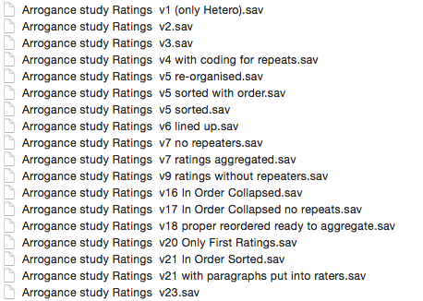
Reproducible research
Basic principle: You (or someone else) should be able to get from your raw data to your final results and get the same results every time
Notes:
Note that the open science framework, where people have been putting their data as part of the open science initiative, often has code in R to replicate people’s analyses.

Slide 9
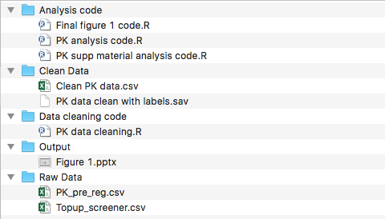
Reproducible research
Reproducible research
Basic principle: You (or someone else) should be able to get from your raw data to your final results and get the same results every time
Notes:
Note that the open science framework, where people have been putting their data as part of the open science initiative, often has code in R to replicate people’s analyses.

Slide 10
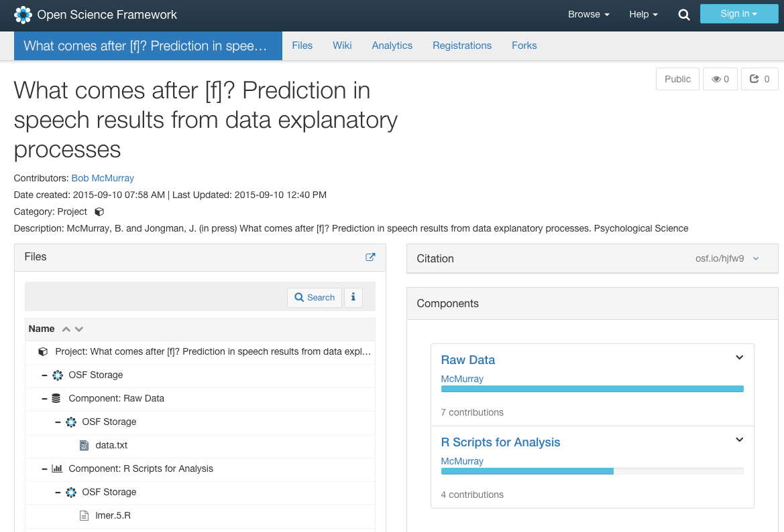
Notes:
An example of one of the first datasets I looked at when I was browsing through psych science open data badges to see if there would be any interesting examples for this course

Slide 11
Other reasons to use R
It’s free (you’ll always have access)
It makes your research reproducible
It dramatically increases the efficiency of your data handling
It opens up new avenues of research
It has the best graphics capabilities around
Notes:
This first point is especially relevant at this time if year when we’re all watching our SPSS licences expire and having trouble accessing SPSS because of it. The department shells out a big hunk of cash every year to pay for SPSS - someday in the future that might not need to be the case. There’s also the fact that you can’t give your students or RAs a laptop with SPSS to work on to take home with them or it’s a constant struggle, while you can do whatever you want with R.

Slide 12
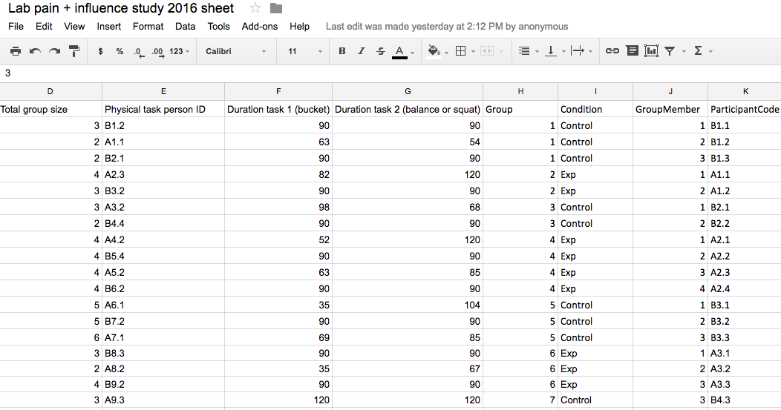
Efficient data handling

Slide 13
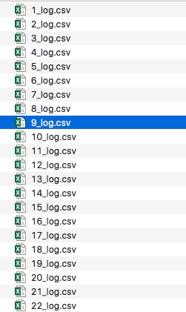
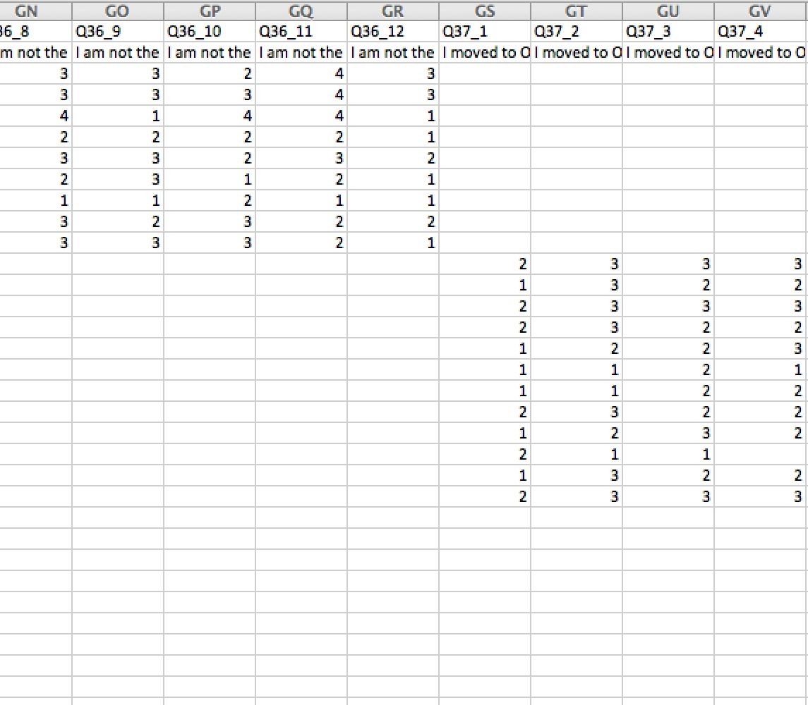
Data Cleaning Problems

Slide 14
Other reasons to use R
It’s free (you’ll always have access)
It makes your research reproducible
It dramatically increases the efficiency of your data handling
It has exceptional graphics capabilities
It opens up new avenues of research
Notes:
This first point is especially relevant at this time if year when we’re all watching our SPSS licences expire and having trouble accessing SPSS because of it. The department shells out a big hunk of cash every year to pay for SPSS - someday in the future that might not need to be the case. There’s also the fact that you can’t give your students or RAs a laptop with SPSS to work on to take home with them or it’s a constant struggle, while you can do whatever you want with R.

Slide 15
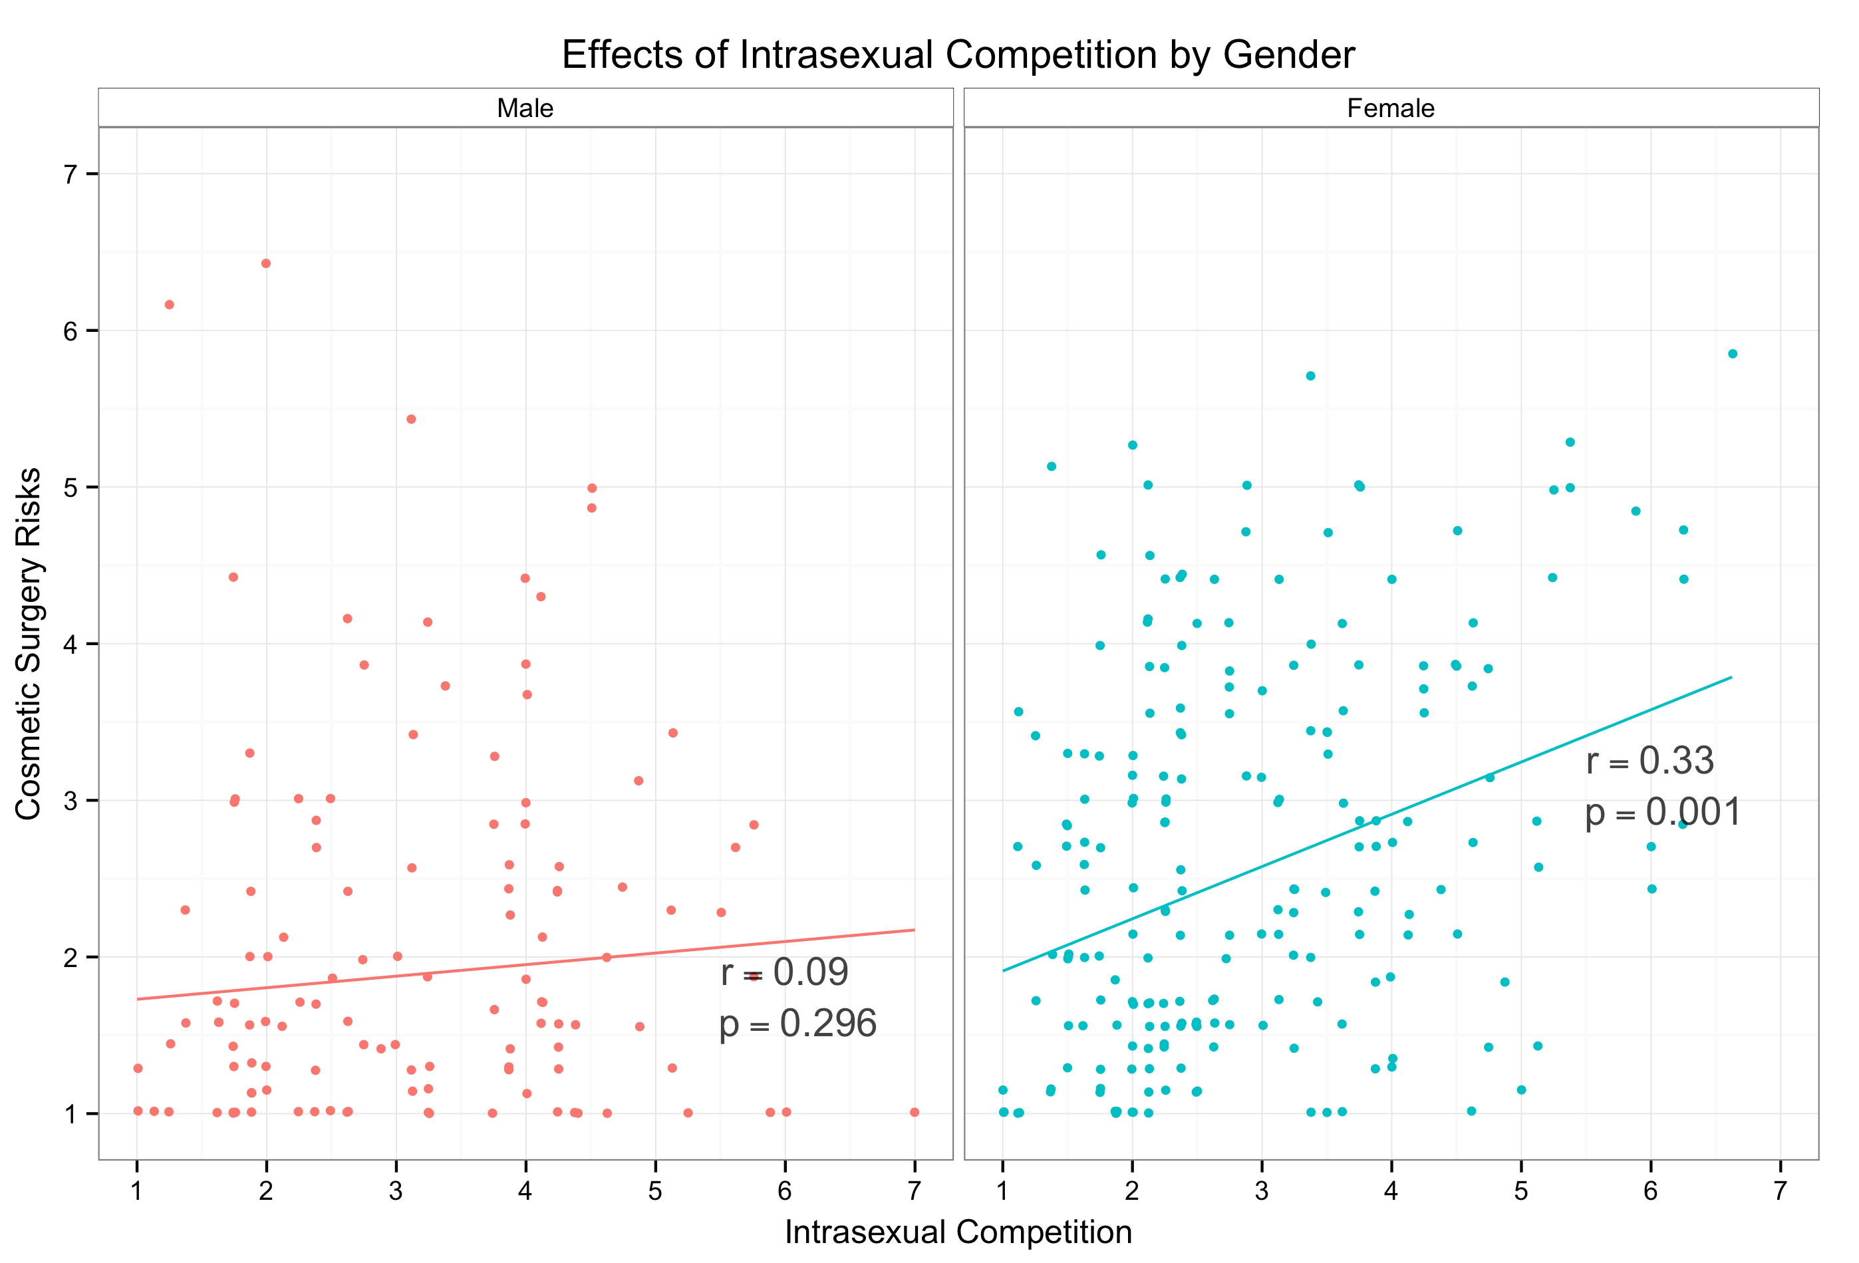

Slide 16
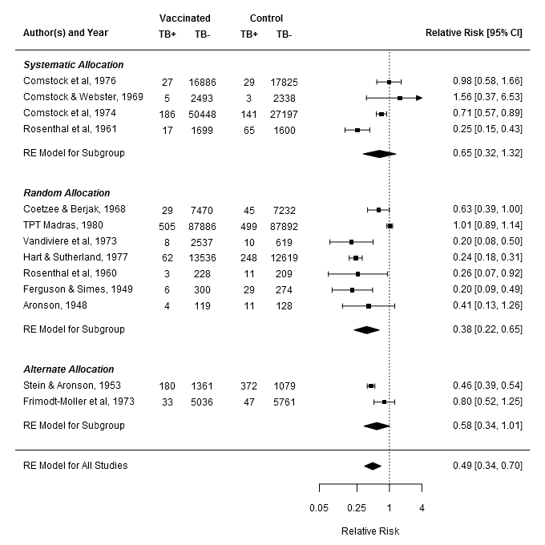

Slide 17
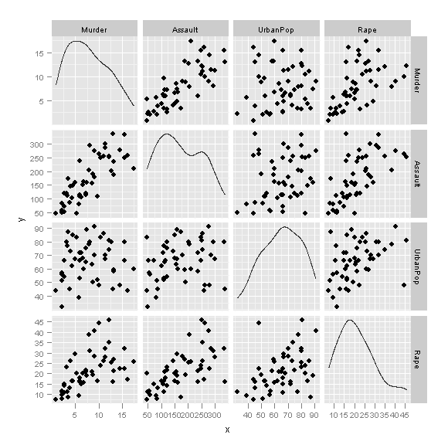

Slide 18
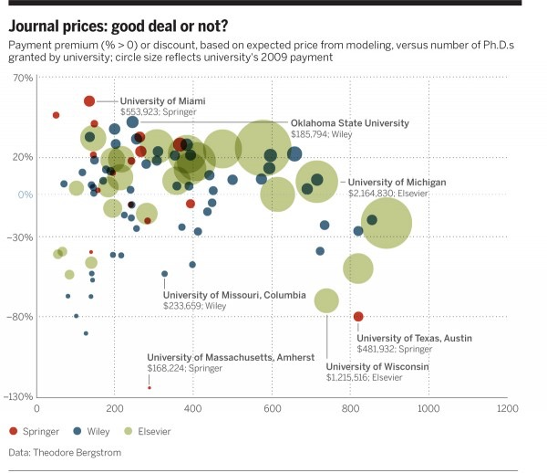
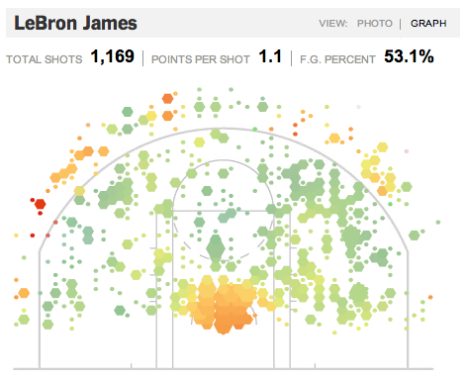
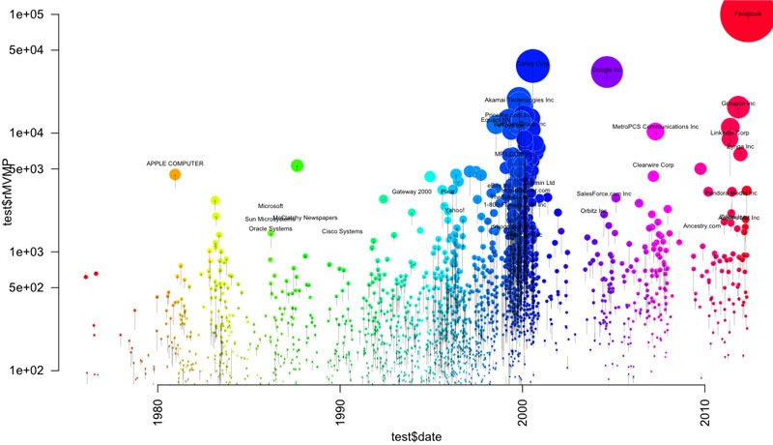
6a010534b1db25970b016305c52b8a970d-800wi

Slide 19
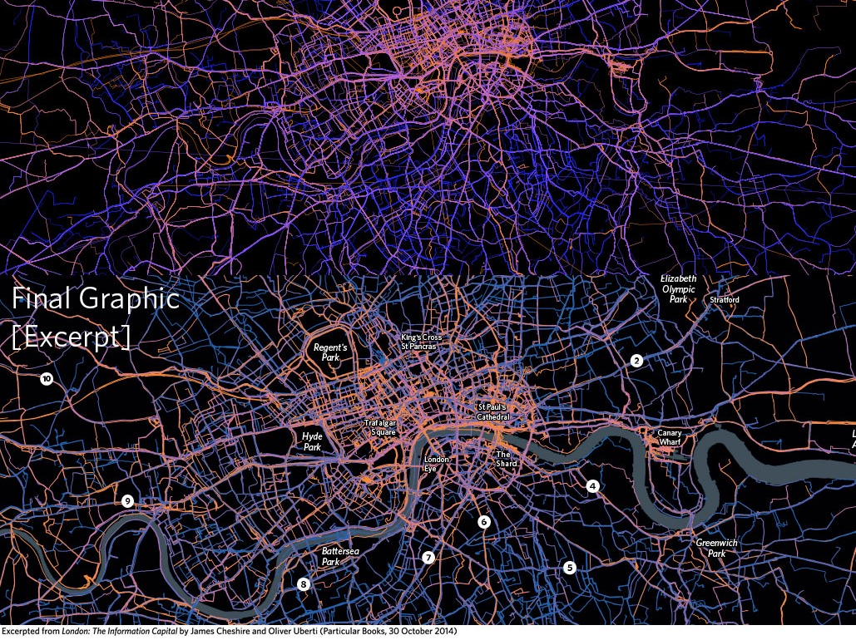

Slide 20
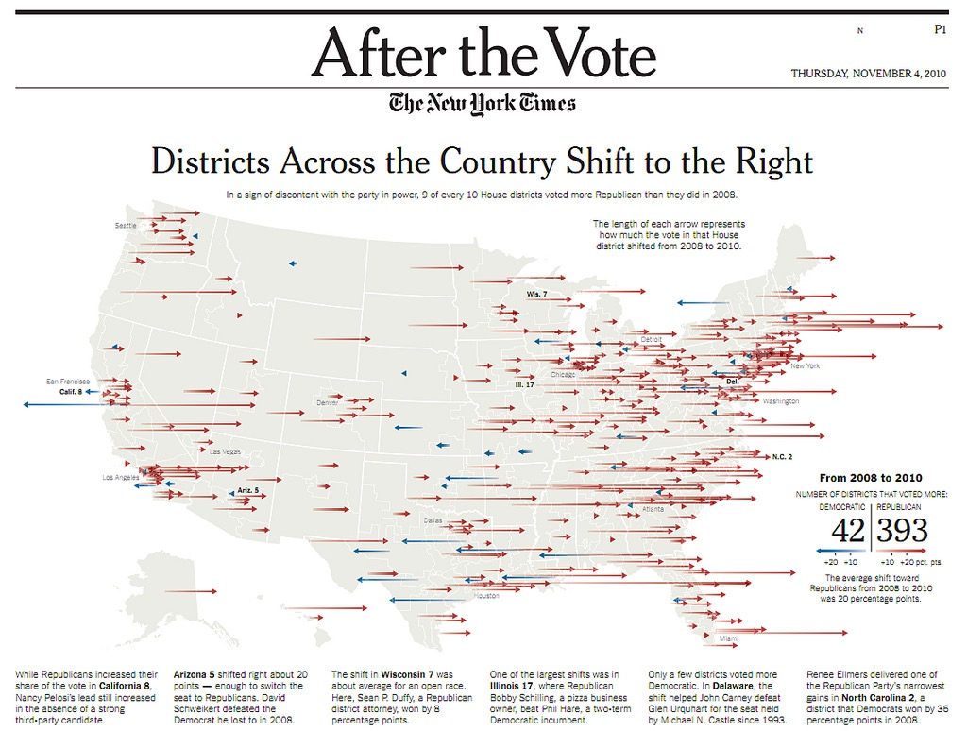

Slide 21
Other reasons to use R
It’s free (you’ll always have access)
It makes your research reproducible
It dramatically increases the efficiency of your data handling
It has exceptional graphics capabilities
It opens up new avenues of research
Notes:
This first point is especially relevant at this time if year when we’re all watching our SPSS licences expire and having trouble accessing SPSS because of it. The department shells out a big hunk of cash every year to pay for SPSS - someday in the future that might not need to be the case. There’s also the fact that you can’t give your students or RAs a laptop with SPSS to work on to take home with them or it’s a constant struggle, while you can do whatever you want with R.

Slide 22
New avenues of research
Can use simulations to create/test/validate new or existing methods
Adds functionality to other services like Mturk or Qualtrics
Can be used to perform web scraping for ‘big data’ research
Can create web applications, presentations, and reports

Slide 23
Why learn the programming side of things?
R is a powerful and flexible language, but that flexibility comes with the potential to make mistakes
Being able to process and manipulate data is essential to many analytic techniques
Knowing the fundamentals will make it much easier to extend your knowledge to new packages and analyses
Notes:
Why I’m going to be walking you through the programming side of R and not just showing you how to run different analyses in R. The analogy is to an alien spaceship. I could walk you around showing specific sequences of buttons that do certain things, but you’d have a hard time extending that if a different use case came up. Also, there’s the chance you’d make a mistake and blow something up because you don’t know what you’re doing.
Also, I hope that you’ll find the problem solving side of programming in R rewarding and eventually may want to extend that ability, as R can do many other things.

